Slide 1
Activity Planning
Constantinos Constantinou
Freya Craig
Edward Gillespie

Slide 2
Why?
Feasibility
Resource Allocation
Costing
Motivation
Coordination
Replanning

Slide 3
What is an “Activity” exactly?
An “Activity” is a task required in order to reach the end of a project.
Activities:
Can be made up of smaller activities
Need a clear start and end date
Must have a predicted resource cost
Must have a predicted duration

Slide 4
Milestones and Delays
A milestone is a completion of a set of activities which mark an important part in the project.
Staff Trained
Software Ready
Issues can also arise that delay the project an change the schedule
Incompatible Software
Staff Sick

Slide 5
Who and When?
An activity plan is a vital aid to any project team
An activity plan is created after the feasibility study
Throughout the project, the plan may be changed to ensure targets are met

Slide 6
Identifying Activities
Activity Based – Create a list of activities that may be involved through brainstorming or previous projects
Product Based – Identify Products to be produced throughout the project
Hybrid – A combination of Activity and Product Based identification

Slide 7
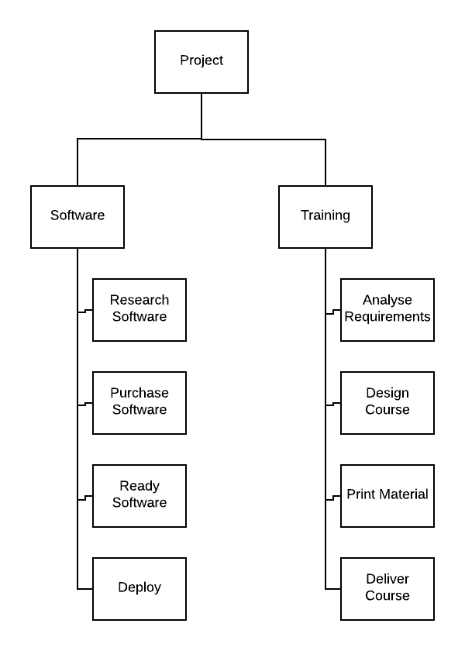
A hybrid Work Breakdown Structure (WBS)

Slide 8
Relationships
Bar Charts – Useful for smaller projects to showing relationships
Network Models – Models the project as a network, with time flowing left to right
Activity-on-arrow – An older approach where activities are arrows connecting nodes
Activity-on-node – A newer method where activities are represented by nodes

Slide 9
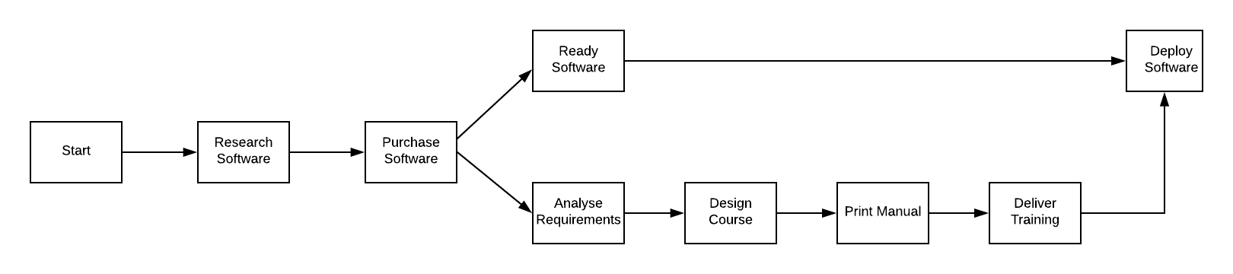
An Arrow-On-Node networking model

Slide 10
Scheduling
Time can be added to a network model to show the scheduling of the project and work out the critical path
Forward pass – Adds the earliest possible start and end date to each activity (left to right)
Backwards pass – Adds the latest possible start and end date to each activity (right to left)
Float – How long an activity can be delayed without affecting the projects end date

Slide 11
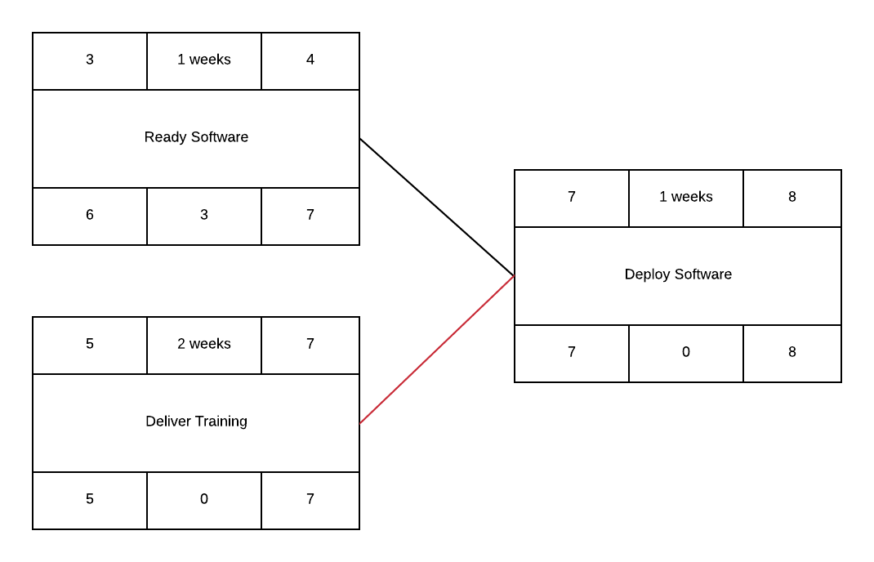
A networking model with Forward and Backward passing

Slide 12
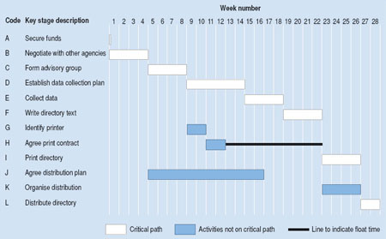
Gantt chart

Slide 13
Critical Path
A critical activity is an activity with 0 float
There will always be a path linking together the critical activities, these activities make up the Critical Path
It is also useful to find near critical activities within the schedule

